Slide 1


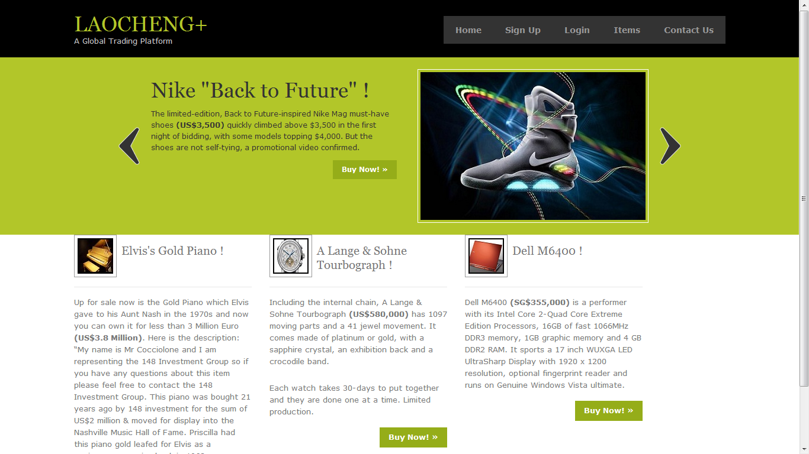
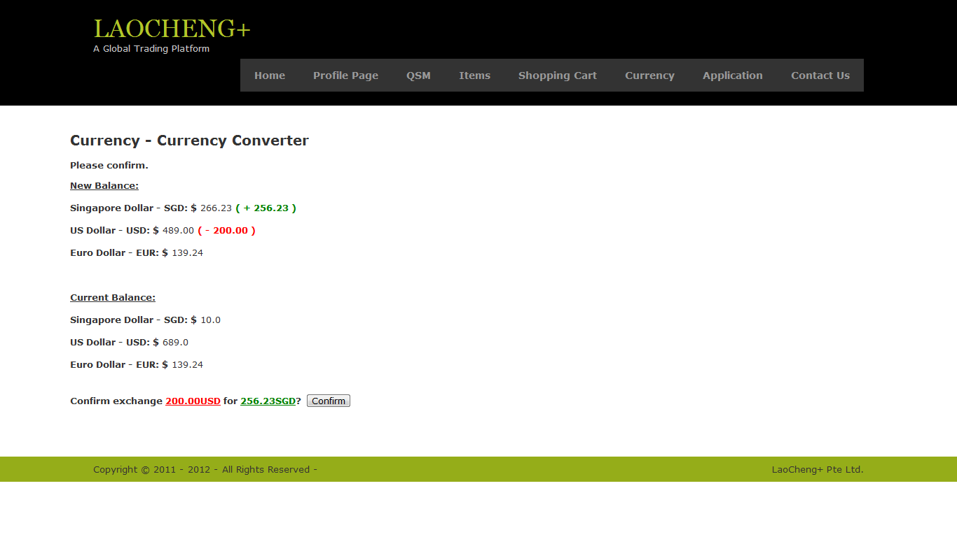
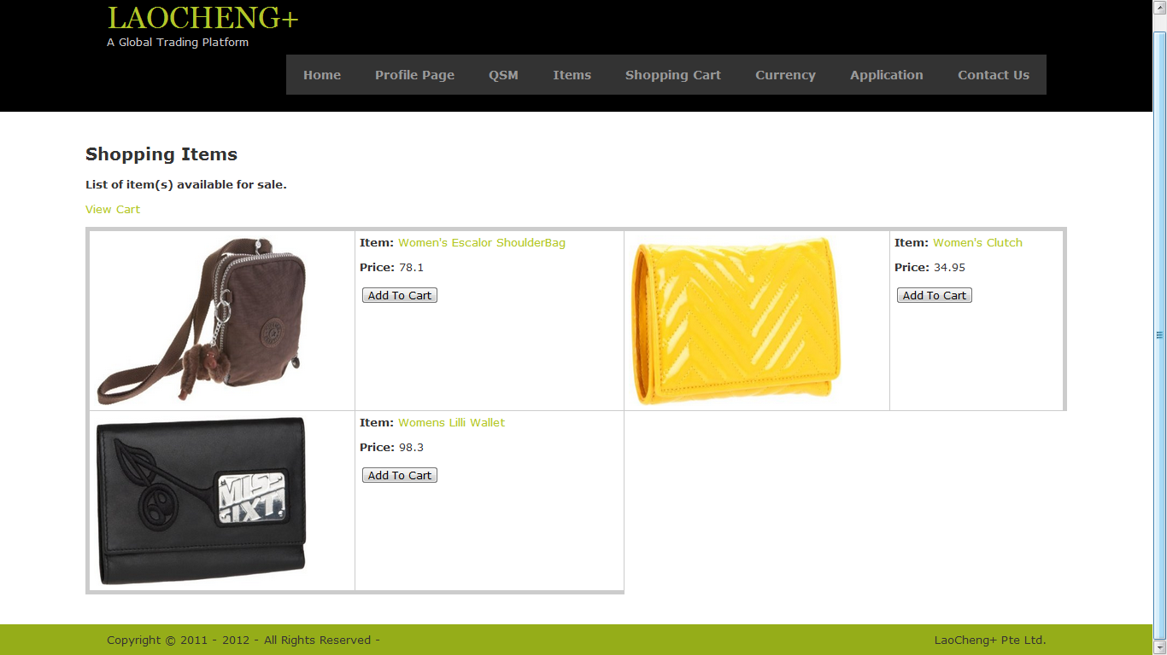
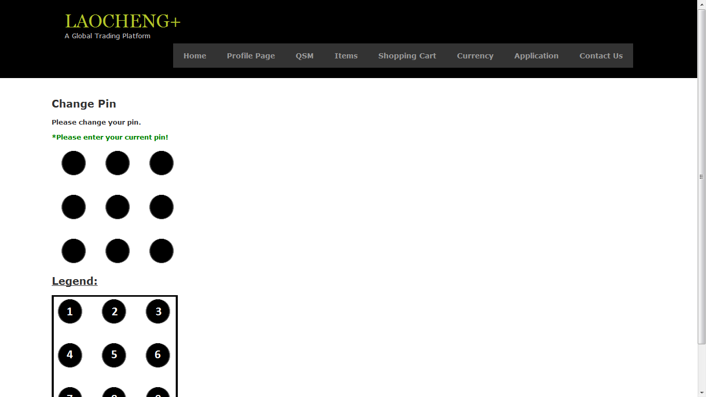
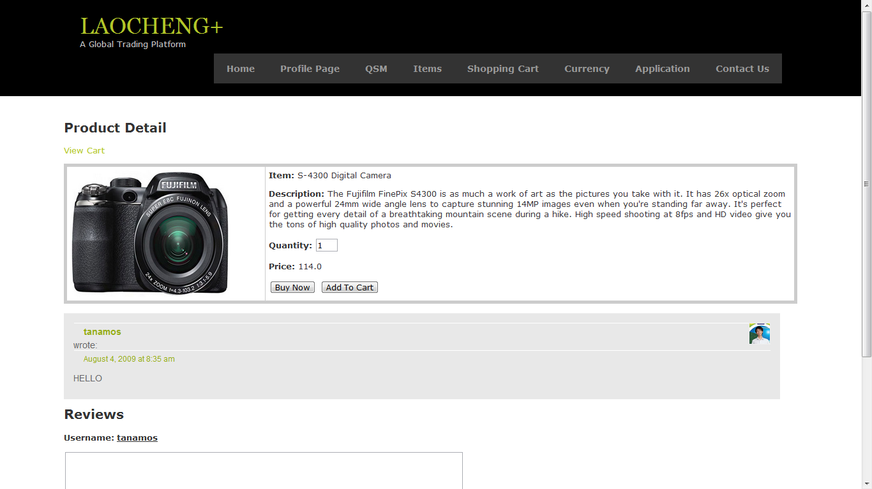
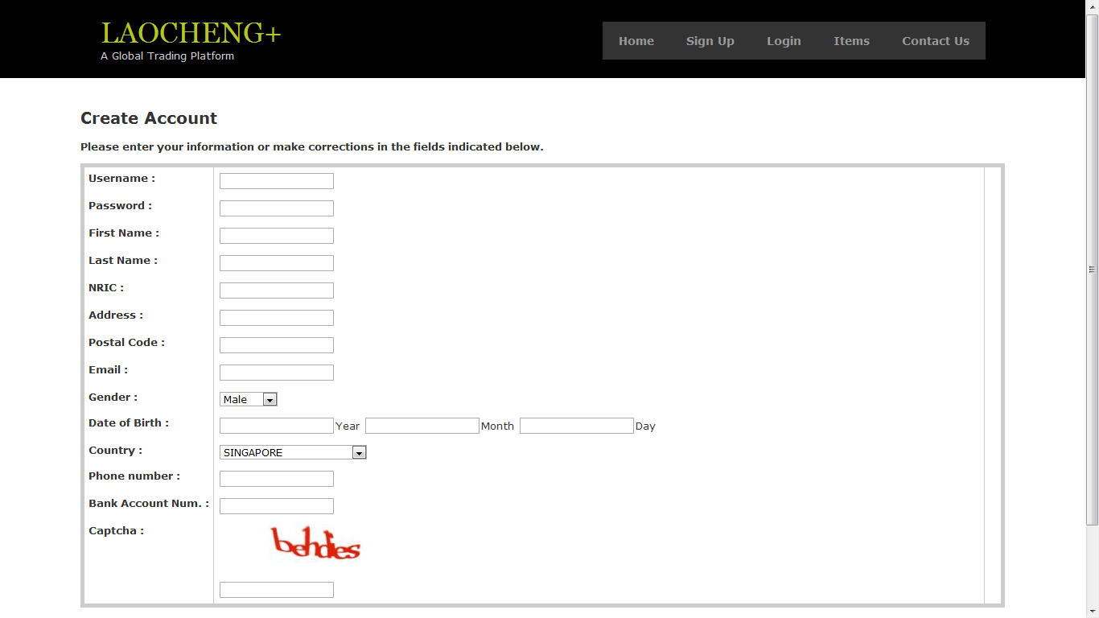
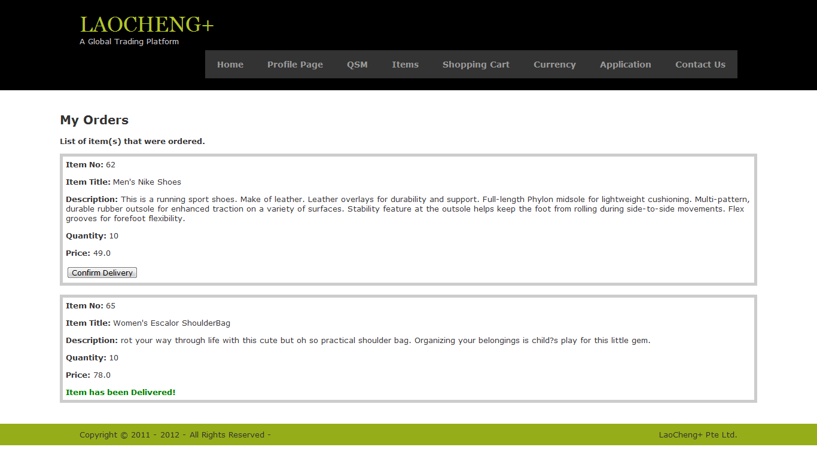
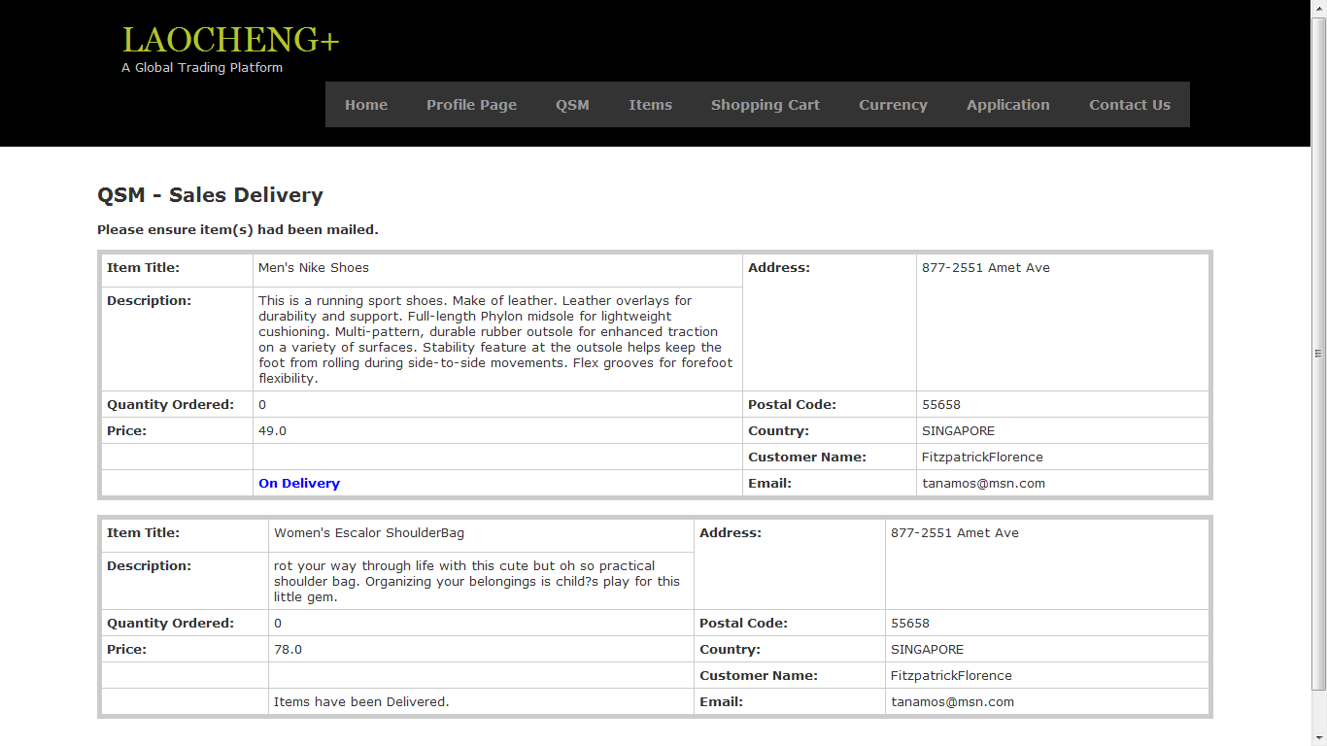
LaoCheng
Alvin Lee, Siew Yuet, Amos Tan, Jian Hao, Wei Chen
DIS1102
Functionality (Business)
Introduction
Functionality (Security)
LaoCheng+ provides unique advantages and exclusive services that only LaoCheng+ clients are able to enjoy-we secure deals between buyer and seller to ensure that both get what they agreed upon, exclusive offers to show our appreciation for people who use LaoCheng+. In addition Foreign Exchange Trading can be done through our system. The various features we offer support our clients from various angles; Business and Consumer. They are all listed below for viewing.
Business
i. Product Management System
ii. Currency Exchange System
iii. Shopping Cart System
iv. Quality Service Management – QSM
Administrative
i. Access Control System
ii. Managing Account System
Our project is an online middle men system for buying and selling of wares and currencies online. It’s named the LaoCheng+; provide security for Users engaging in activities involving the movement of money. It provides various measures to secure the client, not just from malicious characters who threaten our client’s personal data and finances but also from a more over look threats-the person you are dealing with.
In E-Commerce it is possible for either buyer or seller to be cheated as they do not know who they are dealing with and therefore he or she can easily disappear with the client’s money. A solution is to have another person to manage dealings between buyer and seller, making sure a buyer and seller get their end of the deal. LaoCheng+ serves to be that third person. As a fully automated system it will treat all its users in a fair and unbiased manner. As LaoCheng+ is trusted by all affiliated parties you can easily use LaoCheng+ to be the financial middle-men without argument when trading with other LaoCheng+ users and know that they can be trusted.
LaoCheng+ provides security features to guard the personal data and money of our clients. The security features can be divided into various categories based on what they aspect of security are they protecting. These categories are Authentication, Confidentiality and Integrity, Availability and Internal Security. Below are lists of features under each category.
Authentication
i. Two-Factor Authentication (2FA)
ii. Secure Socket Layer
Availability
i. Captcha System
Internal Security
i. 9-dot Security Pin
.
Functionality (Pictures)
Functionality (Pictures)
Main Page:
Business Case
Currency Converter Page:
LaoCheng+ aims to provide a safe avenue for clients when they perform any sort of online activity involving money. Such as paying for products online, selling products online and trading in the Foreign exchange market. The security features we provide to protect our client is network security; encryption algorithms to encrypt sensitive information; checking if integrity of client’s request for services has been compromised; and authenticating that our clients are really who they say they are.
Through these measures we ensure that our client’s personal information is not compromised by an unauthorized intruder. Our network security and encryption algorithm prevents the stealing of information during online transactions. Integrity checking makes sure that our client’s requests do not get modified before they reach the server. Authenticating ensures that only our client can decide whatever he or she wants to do with their money and personal details and no one else.
Our security measures do not just guard against outside threats; LaoCheng+ also has measures to protect our client from within the team. Built in access control ensures that all authorized users actions regarding our client’s data is controlled and that not one individual has control over the whole system. Furthermore, in the event a third party needs to look into our system for various reasons we can ensure that they will only have enough access to do their duty and no more.
LaoCheng+ does not only secure our clients data and money, it also provide ways to clear up potential disputes between buyer and seller. Whenever a client purchases products online, money from a client’s account will not be given to the seller first, only when the client receives the goods will the he or she be given the money. Once the client has confirmed he or she has received the goods, they will not be able to stop LaoCheng+ from transferring the money; Ensuring that no one-buyer or seller-can be cheated so easily when using LaoCheng+ online activities.
Furthermore when confirming purchase we provide non-repudiation to prove that the client bought and gotten hold of the goods and that the seller has received the money. This ensures that they cannot deny purchase or sale later on, dissolving any future legal issues. Such as a buyers complaining of paying the money but not receiving the goods or sellers claiming that they received not payment.
A
B
Shopping Page:
Change Security Pin Page:
Product Details Page (with Reviews):
Registration Page (with 2FA):
Orders Delivery Page:
Sales Delivery Page:

